Slide 1
Traffic Violations Analysis Dashboard
ARGHA NANDI
A comprehensive visualization project demonstrating traffic violation patterns and insights

Slide 2
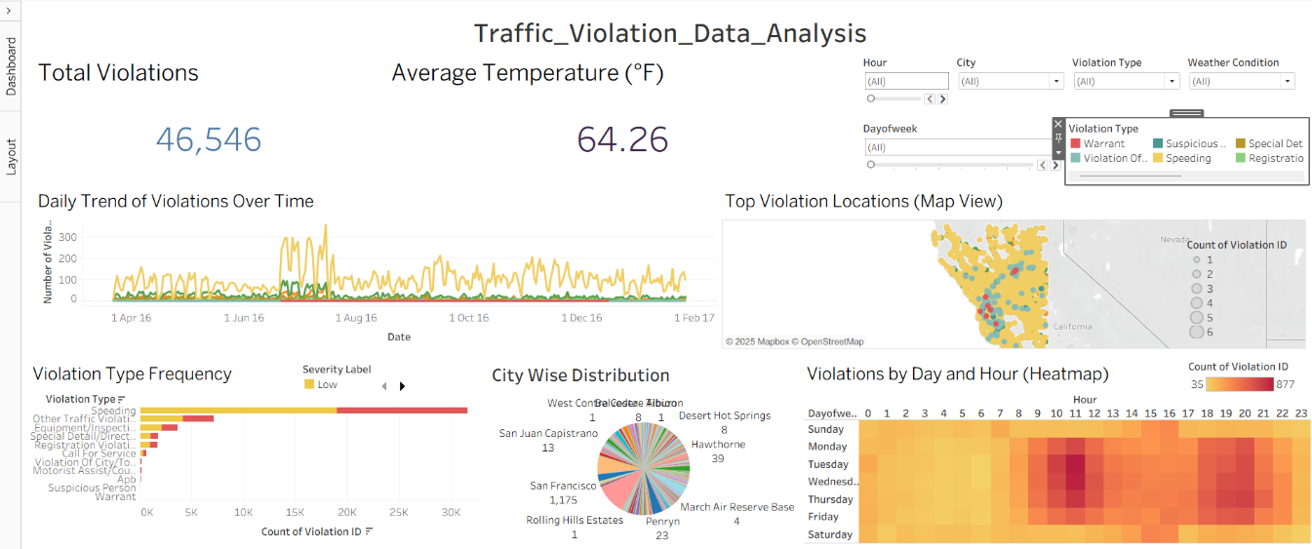
Dashboard Overview
01

Slide 3
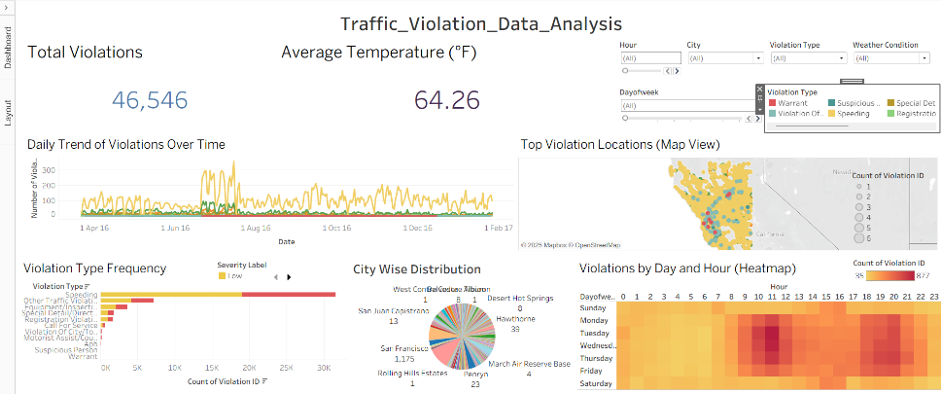
Purpose and Objectives
This dashboard aims to analyze traffic violation data to identify patterns and trends.
It supports decision-making by providing clear insights into the frequency and distribution
of violations, enabling targeted interventions to enhance road safety.

Slide 4
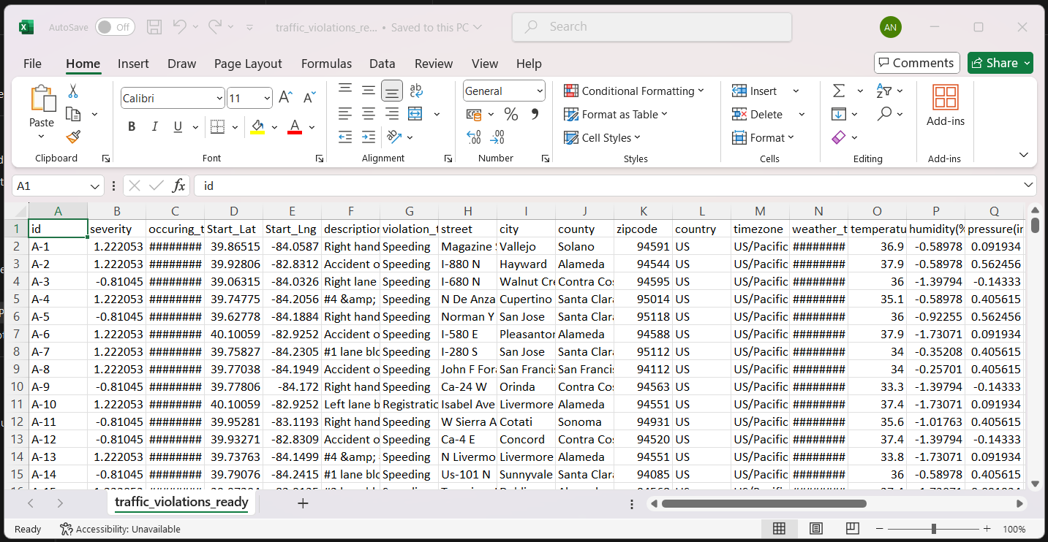
Data Description and Sources
The dataset includes traffic violations recorded across various cities of US, with details such as
violation type, time of occurrence, weather conditions, and day of the week. The data is
filtered and visualized to reveal meaningful patterns and correlations.

Slide 5
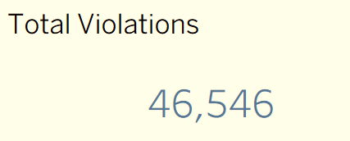
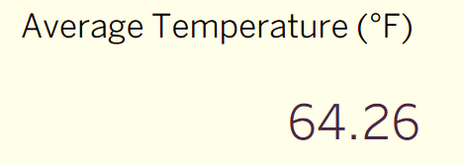
Key Performance Indicators (KPIs)
Key metrics displayed include average temperature and the total number of violations.
These KPIs provide a quick snapshot of the environmental context and violation volume,
helping users grasp the dataset's overall scenario at a glance.

Slide 6
Visualisation Techniques
02

Slide 7
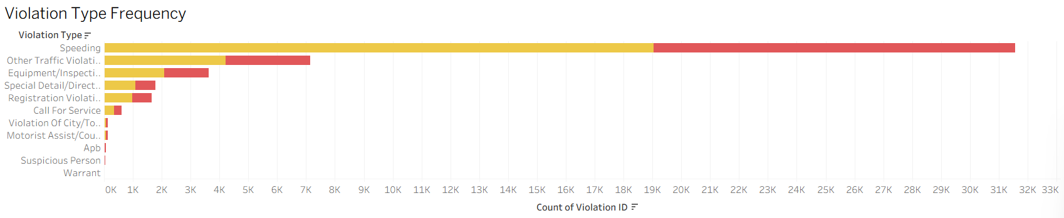
Bar Chart: Violation Type Frequency
This bar chart illustrates the frequency of different traffic violation types.
It highlights which violations occur most often, providing a clear comparison of their relative prevalence.
This helps prioritize areas for enforcement and resource allocation.

Slide 8
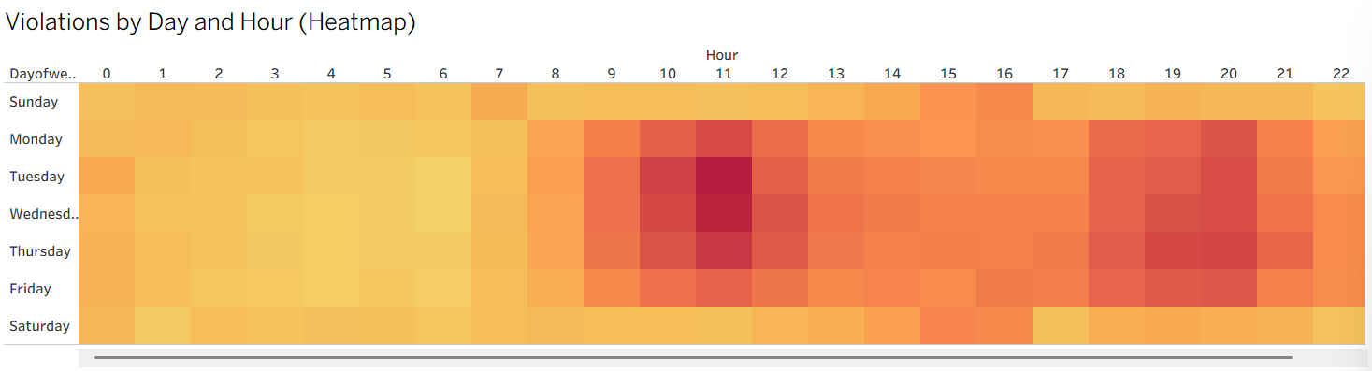
Heatmap: Violations by Day and Hour
The heatmap visualizes the density of violations by day of the week and hour of the day.
This enables identification of peak violation times and helps understand temporal patterns in traffic behavior,
facilitating targeted interventions during high-risk periods.

Slide 9
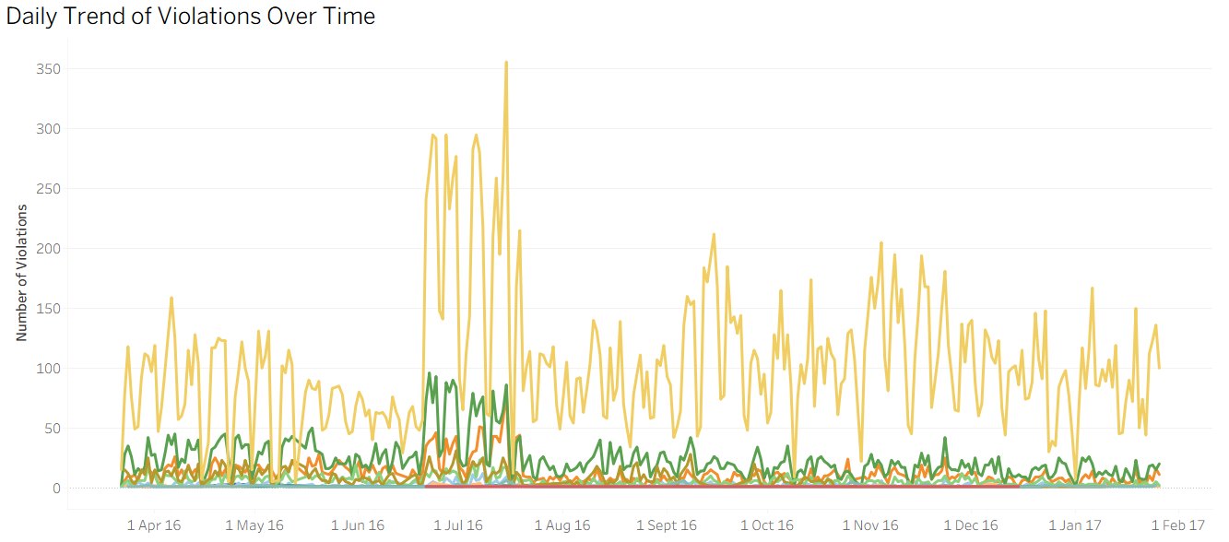
Line Chart: Violations Over Time by Type
This line chart shows trends in the number of violations over time, broken down by violation type.
It tracks increases or decreases in specific violations, supporting strategic planning and monitoring of enforcement impact.

Slide 10
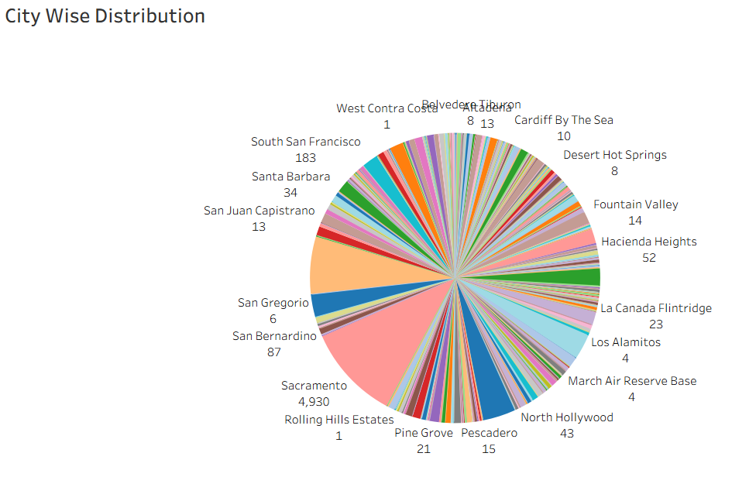
Pie Chart: Distribution of Violations by City
The pie chart displays how traffic violations are distributed across different cities.
It provides a quick visual understanding of which cities have higher violation shares, aiding in geographic-focused enforcement strategies.

Slide 11
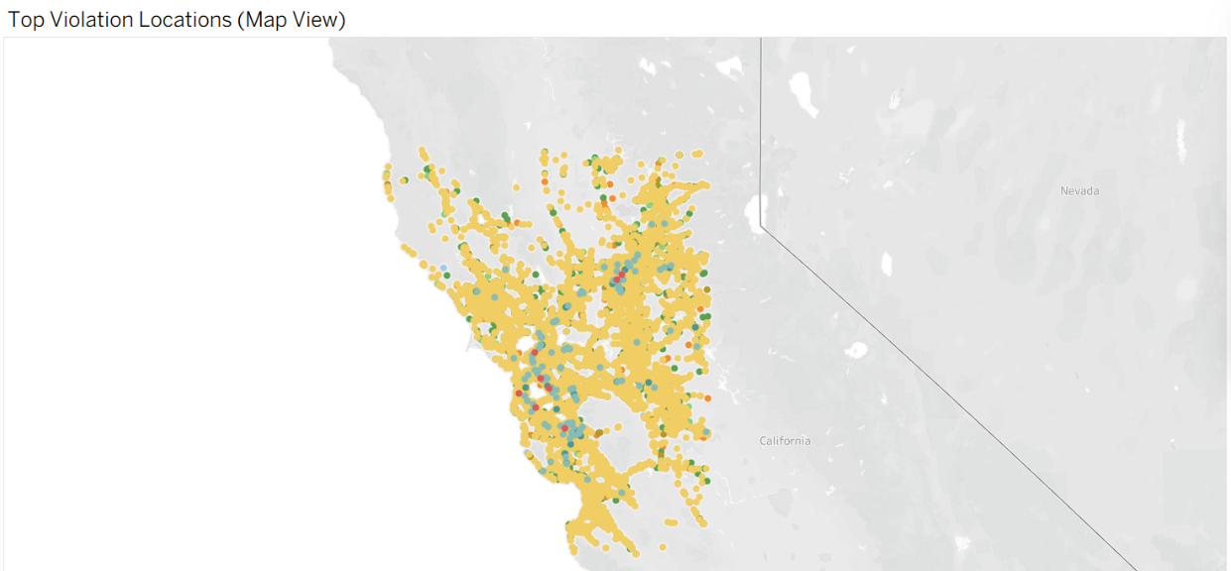
Map: Violation Hot Zones and Locations
This map highlights geographic hot zones where violations are concentrated.
It identifies specific locations with high violation counts, assisting in resource deployment and local safety improvements.

Slide 12
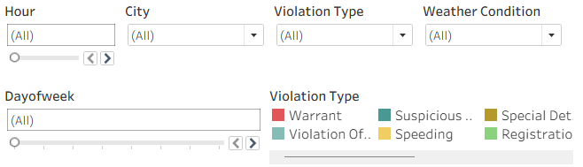
Interactivity Features: Filters and User Experience
Interactive filters for city, hour, weather condition, violation type, and day of the week allow users to customize views.
This enhances user experience by enabling smooth, focused analysis and deeper insight extraction tailored to specific needs.

Slide 13
Conclusions
The dashboard effectively integrates diverse visualization techniques and interactive filters to present a comprehensive analysis of traffic violations.
Its design supports data-driven decision-making, enabling users to identify key patterns regarding violation types, timing, locations, and environmental factors.
This fosters targeted interventions to improve traffic safety and enforcement efficiency.
Thank you!

